Slide 1

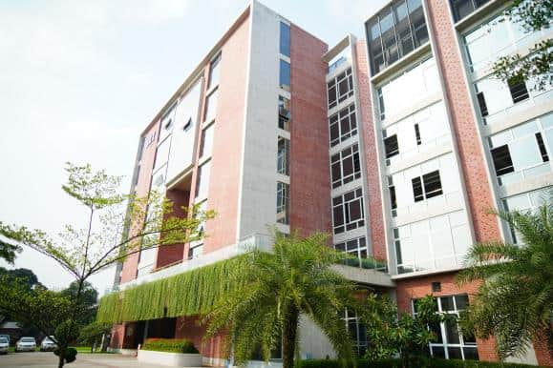
COMPANY PROFILE
MNR GROUP
Premium Sweater Manufacturer

Slide 2
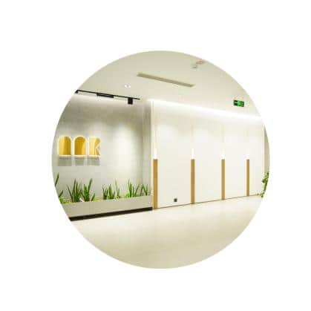
Table of Contents
ABOUT COMPANY
VISION & MISSION
OUR PROJECTS
OUR CUSTOMERS
CUSTOMER MIX
CERTIFICATIONS
QUALITY CONTROL SOP
EQUIPMENTS & CAPACITY
FACTORY OVERVIEW
PRODUCT OVERVIEW
YARN HANDLING
LEAD TIME
OUR PRODUCTS
SUSTAINABILITY
ENERGY EFFICIENT
CONTACTS

Slide 3
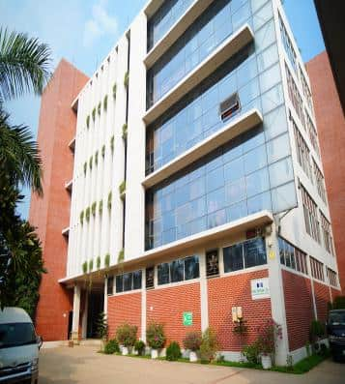
About Company
MNR Group is one of the leading sweater manufacturing groups of companies having three owned production units - MNR Design Ltd, MNR Sweaters Ltd and Welldone Apparel Ltd since its inauguration in 1998.
MNR Group has demonstrated its full commitment towards delivering quality products and services that enabled the organization surpass the expectation of its customers across the world. The organization’s client base includes renowned international retailers and the biggest brands of the apparel industry.
We are offering wide product range to the valuable clients, which is the biggest strength of this Organization. With three production units MNR Group is producing 100% Cashmere wool, 100% Merino wool, 100% Lamb’s wool and wool blend products beside local and imported fancy yarn with join life.
We are able to produce all kinds of jacquard knitting including intarsia in a short lead time where most of them are in Shima Seiki brand.

Slide 4

Vision & Mission
VISION
MISSION
To be the number one premier industrial group in Bangladesh ,
by increasing production and export volumes with
exceptional performance.
Care for our clients, communities and employees. Maintaining a high standard of business ethics. Corporate practice in management system. Building a culture of honesty, integrity and accountability.

Slide 5
Our Projects
MNR GROUP
WELLDONE APPAREL LTD.
MNR SWEATERS LTD.
MNR DESIGN LTD.

Slide 6
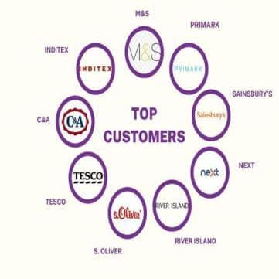
Our Customers
TOP CUSTOMERS
M&S
INDITEX
C&A
TESCO
NEXT
S. OLIVER
SAINSBURY’S
PRIMARK
RIVER ISLAND

Slide 7
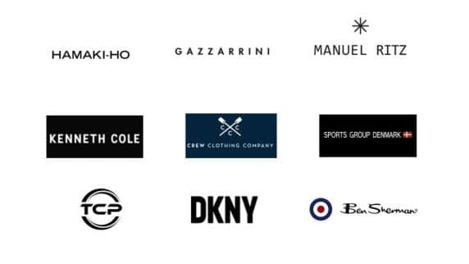
OUR CUSTOMERS
HIGH END CUSTOMERS
GAZZARRINI
MANUEL RITZ
HAMAKI – HO
DKNY
BEN SHARMAN
KENNETH COLE
TCP
SG DENMARK
CREW CLOTHING

Slide 8
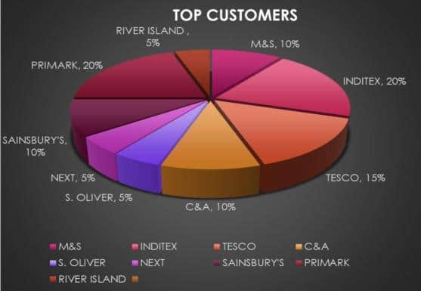
CUSTOMER MIX

Slide 9
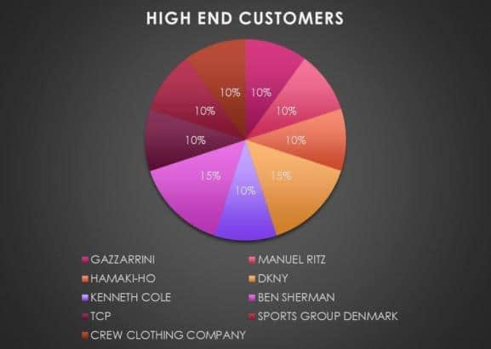
CUSTOMER MIX

Slide 10
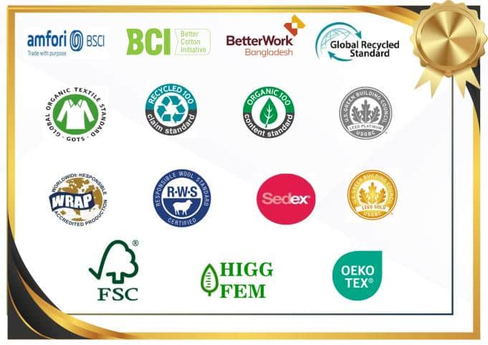
Certification

Slide 11
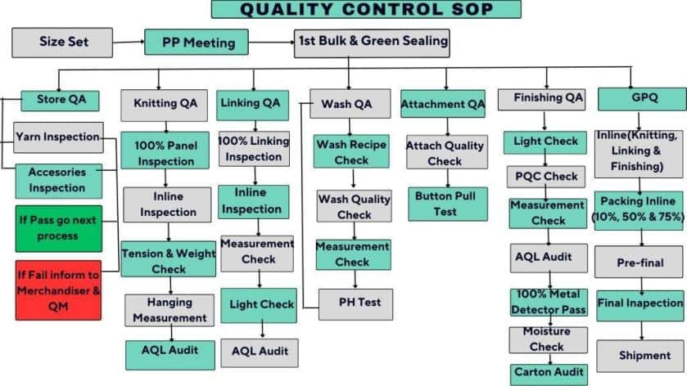

Slide 12
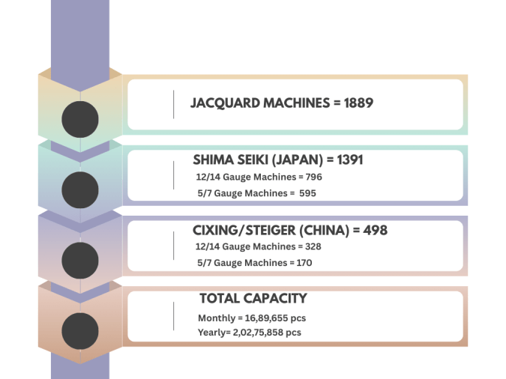
MACHINERIES & CAPACITY

Slide 13
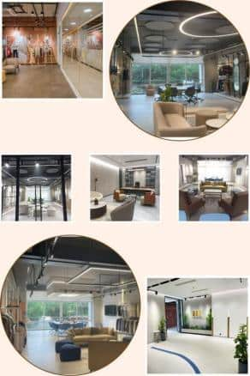
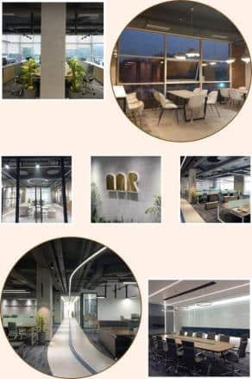
FACTORY OVERVIEW

Slide 14
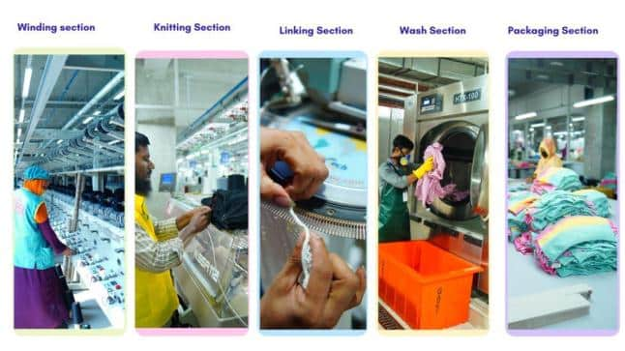
FACTORY OVERVIEW

Slide 15
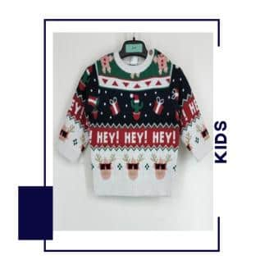
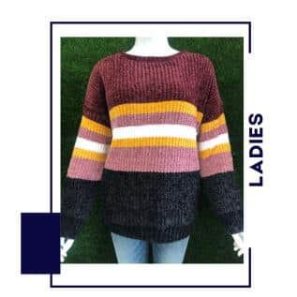
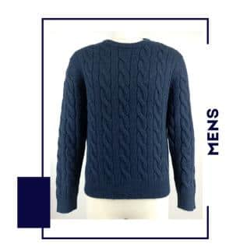
PRODUCT OVERVIEW

Slide 16
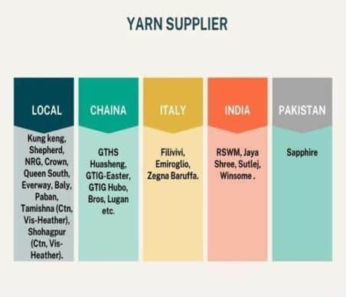
YARN HANDLING

Slide 17
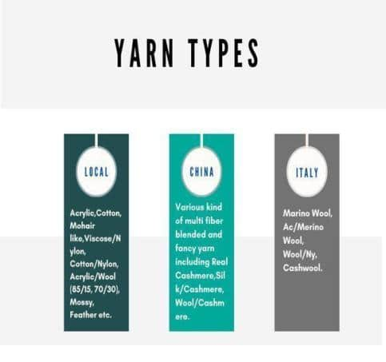
YARN HANDLING

Slide 18
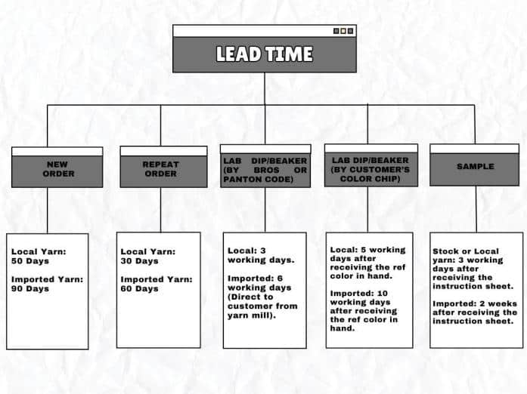

Slide 19

SUSTAINABILITY
Ensure Buyer Satisfaction
Ensure Quality Product, Product Safety & Strong QMS
On Time Delivery & Shipment
Capacity with Short Lead-Time
Strong Man Management System
ETP & WTP
Innovation
Highly Conscious in Environment in LEED with Gold & Platinum Certification

Slide 20





ENERGY EFFICIENT
EGB BOILER
ROOF TOP SOLAR
SERVO MOTOR
CHILLER
GAS GENERATOR

Slide 21






CONTACTS
Connect with Us!
Feel free to reach out to us for further information!
Bank Details
Mercantile Bank Ltd.
Gulshan Branch,106 Gulshan Avenue. Dhaka 1212, Bangladesh.
Phone #+880-028835276
Fax # +880-02-8835614.
SWIFT: MBLBBDDH019
Name: Golam Mostofa
Managing Director
Cell : +880 1929913111
E-mail: mostofa@mnrgroupbd.com
Corporate Office
House :488 (1st & 2nd Floor),Road : 8, Baridhara DOHS ,Dhaka-1206.
Name: Md . Rafiqul Islam
General Manager
(Marketing & Merchandising)
Cell : +880 1929913150
E-mail : rafique@mnrgroupbd.com
Factory Office
Baraider Chala, Sreepur,Gazipur, Bangladesh.

Slide 22


